Slide 1

AI training group
Weekly Report
Nguyen khai phu – JUL 14 2023

Slide 2
Section 8: Convolutional Neural Networks
ISP008 foundation
Convolutional layer:
Local connection
3D filters
Multiple filters
Convolutional layers are often fed into another convolutional layer
-> extract complex features
2
Internal | C/ISP Krautschneider | 07.12.2017 V1.0
CISP-1352-A21 - ISP-DOC-STYLETYPE-Templates © Robert Bosch GmbH 2016. All rights reserved, also regarding any disposal, exploitation, reproduction, editing, distribution, as well as in the event of applications for industrial property rights.

Slide 3
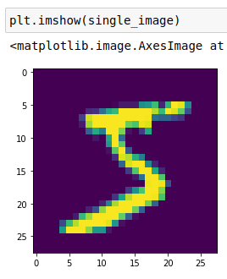
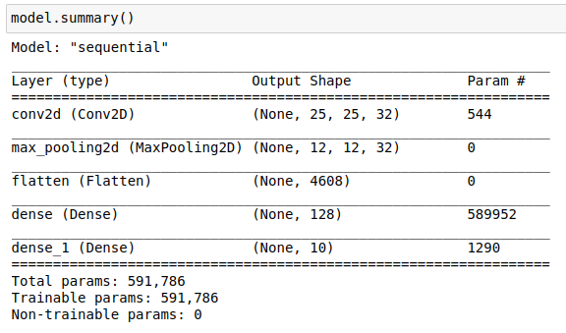
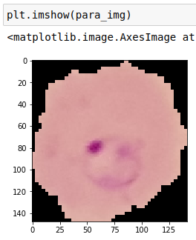
Section 8: Convolutional Neural Networks
ISP008 foundation
image_gen = ImageDataGenerator(rotation_range=20,
width_shift_range=0.10,
height_shift_range=0.10,
rescale=1/255,
shear_range=0.1,
zoom_range=0.1,
horizontal_flip=True,
fill_mode='nearest')
2
Internal | C/ISP Krautschneider | 07.12.2017 V1.0
CISP-1352-A21 - ISP-DOC-STYLETYPE-Templates © Robert Bosch GmbH 2016. All rights reserved, also regarding any disposal, exploitation, reproduction, editing, distribution, as well as in the event of applications for industrial property rights.

Slide 4

Section 9: Recurrent Neural Networks
ISP008 foundation
2
Internal | C/ISP Krautschneider | 07.12.2017 V1.0
CISP-1352-A21 - ISP-DOC-STYLETYPE-Templates © Robert Bosch GmbH 2016. All rights reserved, also regarding any disposal, exploitation, reproduction, editing, distribution, as well as in the event of applications for industrial property rights.

Slide 5
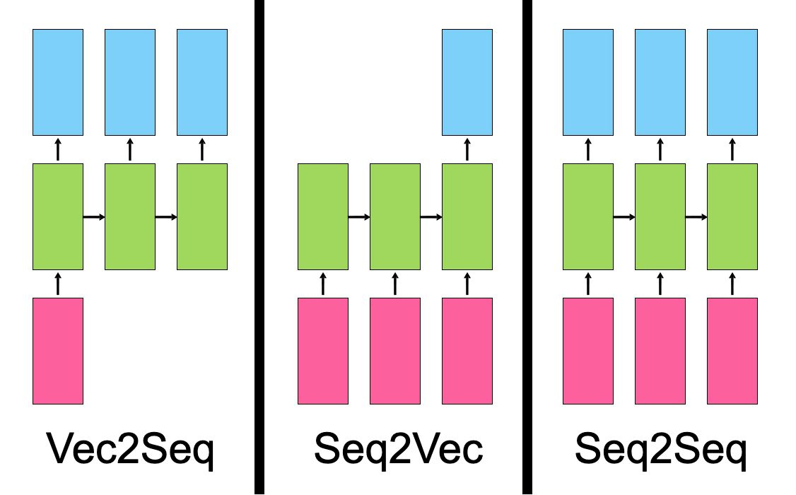
Section 9: Recurrent Neural Networks
ISP008 foundation
RNN disadvantages:
Vanishing gradient
Exploding gradient
Forget long-term memory
2
Internal | C/ISP Krautschneider | 07.12.2017 V1.0
CISP-1352-A21 - ISP-DOC-STYLETYPE-Templates © Robert Bosch GmbH 2016. All rights reserved, also regarding any disposal, exploitation, reproduction, editing, distribution, as well as in the event of applications for industrial property rights.

Slide 6
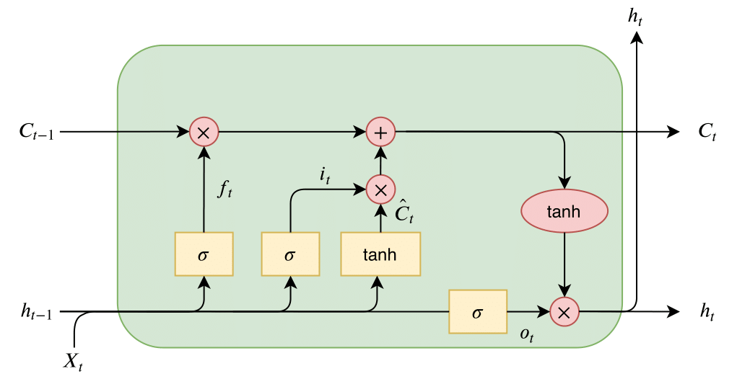
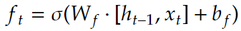
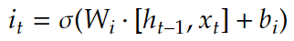
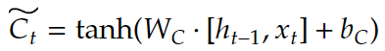
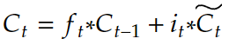
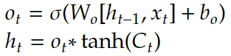
Section 9: Recurrent Neural Networks
ISP008 foundation
2
Internal | C/ISP Krautschneider | 07.12.2017 V1.0
CISP-1352-A21 - ISP-DOC-STYLETYPE-Templates © Robert Bosch GmbH 2016. All rights reserved, also regarding any disposal, exploitation, reproduction, editing, distribution, as well as in the event of applications for industrial property rights.

Slide 7
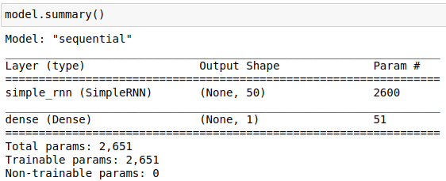
Section 9: Recurrent Neural Networks
ISP008 foundation
Generate batches
from tensorflow.keras.preprocessing.sequence import TimeseriesGenerator
generator = TimeseriesGenerator(data,targets,length,batch_size)
Create & train model
2
Internal | C/ISP Krautschneider | 07.12.2017 V1.0
CISP-1352-A21 - ISP-DOC-STYLETYPE-Templates © Robert Bosch GmbH 2016. All rights reserved, also regarding any disposal, exploitation, reproduction, editing, distribution, as well as in the event of applications for industrial property rights.

Slide 8
Section 9: Recurrent Neural Networks
ISP008 foundation
Prediction loop
test_predictions = [] //store predictions
current_batch = train[-length:].reshape((1, length, n_features))
for i in range(len(test)):
current_pred = model.predict(current_batch)[0]
test_predictions.append(current_pred)
current_batch = np.append(current_batch[:,1:,:], [current_pred], axis=1)
Inverse transform
true_predictions = scaler.inverse_transform(test_predictions)
2
Internal | C/ISP Krautschneider | 07.12.2017 V1.0
CISP-1352-A21 - ISP-DOC-STYLETYPE-Templates © Robert Bosch GmbH 2016. All rights reserved, also regarding any disposal, exploitation, reproduction, editing, distribution, as well as in the event of applications for industrial property rights.

Slide 9
Section 10: Natural Language Processing
ISP008 foundation
Raw corpus
Generate batches
Text vectorization
Create & train model
Generate text
2
Internal | C/ISP Krautschneider | 07.12.2017 V1.0
CISP-1352-A21 - ISP-DOC-STYLETYPE-Templates © Robert Bosch GmbH 2016. All rights reserved, also regarding any disposal, exploitation, reproduction, editing, distribution, as well as in the event of applications for industrial property rights.

Slide 10
Video defect detection using Deep Learning Techniques

Slide 11
Problem analysis
ISP008 foundation
Types of video defects:
Impulse noise
Aliasing, blur
Scratches and blotches
Periodic noise
Snow
Freeze frame
2
Internal | C/ISP Krautschneider | 07.12.2017 V1.0
CISP-1352-A21 - ISP-DOC-STYLETYPE-Templates © Robert Bosch GmbH 2016. All rights reserved, also regarding any disposal, exploitation, reproduction, editing, distribution, as well as in the event of applications for industrial property rights.

Slide 12
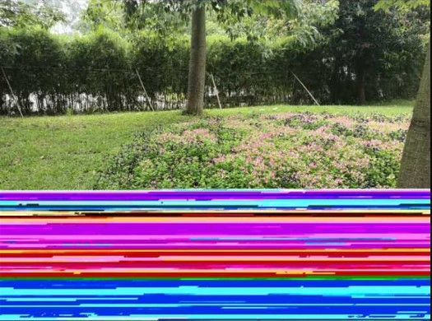
Problem analysis
ISP008 foundation
Types of video defects:
Impulse noise
Aliasing, blur
Scratches and blotches
Periodic noise
Snow
Freeze frame
Color channel interference
2
Internal | C/ISP Krautschneider | 07.12.2017 V1.0
CISP-1352-A21 - ISP-DOC-STYLETYPE-Templates © Robert Bosch GmbH 2016. All rights reserved, also regarding any disposal, exploitation, reproduction, editing, distribution, as well as in the event of applications for industrial property rights.

Slide 13
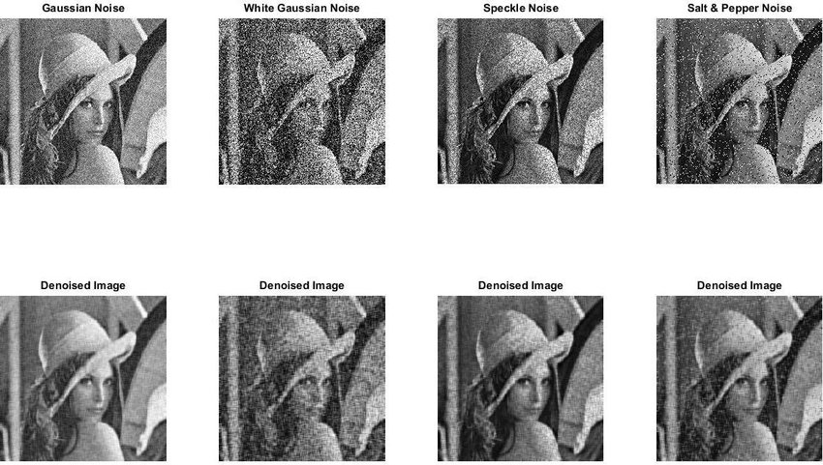
Impulse noise
ISP008 foundation
Impulse noises come in different degrees
2
Internal | C/ISP Krautschneider | 07.12.2017 V1.0
CISP-1352-A21 - ISP-DOC-STYLETYPE-Templates © Robert Bosch GmbH 2016. All rights reserved, also regarding any disposal, exploitation, reproduction, editing, distribution, as well as in the event of applications for industrial property rights.

Slide 14



Impulse noise
ISP008 foundation
Impulse noises come in different degrees
Certain types of noises are unavoidable, even with professional cameras (e.g. shot noise, Gaussian noise, read noise,...)
Images/Videos are made to be viewed by humans -> require subjective evaluation
2
Internal | C/ISP Krautschneider | 07.12.2017 V1.0
CISP-1352-A21 - ISP-DOC-STYLETYPE-Templates © Robert Bosch GmbH 2016. All rights reserved, also regarding any disposal, exploitation, reproduction, editing, distribution, as well as in the event of applications for industrial property rights.

Slide 15

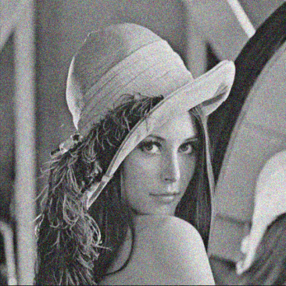
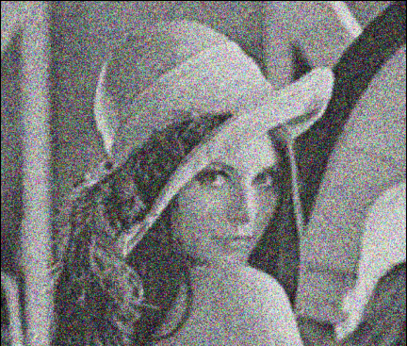
Impulse noise
ISP008 foundation
An objective evaluation method should includes:
A metric to measure “noise level”
Threshold to determine noisy images
2
Internal | C/ISP Krautschneider | 07.12.2017 V1.0
CISP-1352-A21 - ISP-DOC-STYLETYPE-Templates © Robert Bosch GmbH 2016. All rights reserved, also regarding any disposal, exploitation, reproduction, editing, distribution, as well as in the event of applications for industrial property rights.

Slide 16
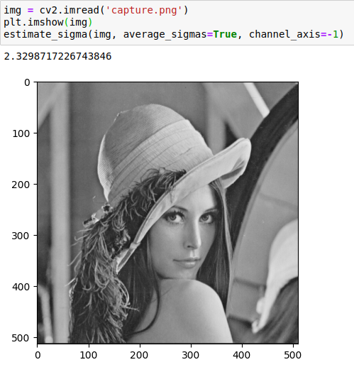
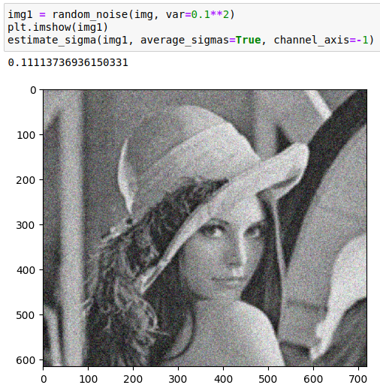
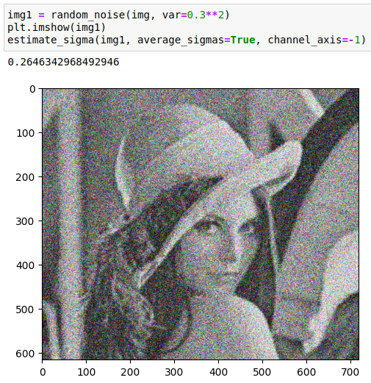
Impulse noise
ISP008 foundation
An objective evaluation method should includes:
A metric to measure “noise level”
Threshold to determine noisy images
2
Internal | C/ISP Krautschneider | 07.12.2017 V1.0
CISP-1352-A21 - ISP-DOC-STYLETYPE-Templates © Robert Bosch GmbH 2016. All rights reserved, also regarding any disposal, exploitation, reproduction, editing, distribution, as well as in the event of applications for industrial property rights.

Slide 17
Impulse noise
ISP008 foundation
An objective evaluation method should includes:
A metric to measure “noise level”
Threshold to determine noisy images
2
Internal | C/ISP Krautschneider | 07.12.2017 V1.0
CISP-1352-A21 - ISP-DOC-STYLETYPE-Templates © Robert Bosch GmbH 2016. All rights reserved, also regarding any disposal, exploitation, reproduction, editing, distribution, as well as in the event of applications for industrial property rights.

Slide 18
Other types of noises
ISP008 foundation
Aliasing, blur
The approach is similar to impulse noise
Freeze frame
Count number of consecutive frames with abs difference = 0
01
04
02
Scratches and blotches
Hough transform
05
Snow
???
03
Periodic noise
Fast Fourier transform
06
Color channel interference
???
2
Internal | C/ISP Krautschneider | 07.12.2017 V1.0
CISP-1352-A21 - ISP-DOC-STYLETYPE-Templates © Robert Bosch GmbH 2016. All rights reserved, also regarding any disposal, exploitation, reproduction, editing, distribution, as well as in the event of applications for industrial property rights.

Slide 19
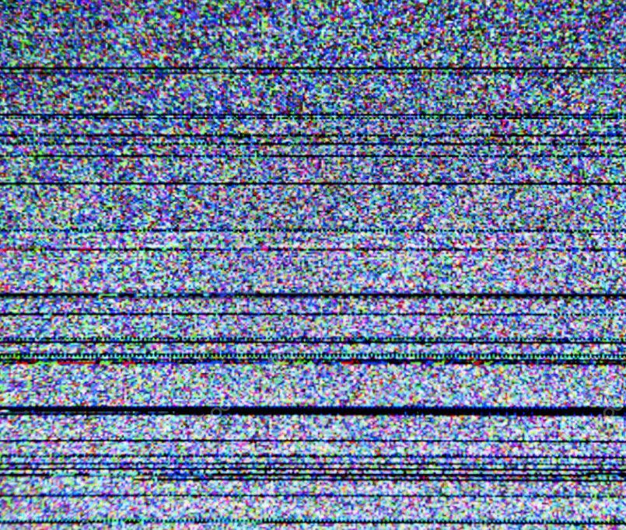
Other types of noises
ISP008 foundation
2
Internal | C/ISP Krautschneider | 07.12.2017 V1.0
CISP-1352-A21 - ISP-DOC-STYLETYPE-Templates © Robert Bosch GmbH 2016. All rights reserved, also regarding any disposal, exploitation, reproduction, editing, distribution, as well as in the event of applications for industrial property rights.

Slide 20
Reference
ISP008 foundation
Detection and Removal of Global and Local Noise in Realtime Video Streams (canterbury.ac.nz)
Image quality assessment: from error visibility to structural similarity | IEEE Journals & Magazine | IEEE Xplore
A new impulse detector for switching median filters | Request PDF (researchgate.net)
A video directional weighted median filter with adaptive threshold and colour correction | IEEE Conference Publication | IEEE Xplore
Salt-and-pepper noise removal by median-type noise detectors and detail-preserving regularization | IEEE Journals & Magazine | IEEE Xplore
Detection and Removal of Global and Local Noise in Realtime Video Streams (canterbury.ac.nz)
Real-Time Noise Level Detection for General Video - Chinatsu Mori, and Seiichi Gohshi
[2208.08597] Restoration of User Videos Shared on Social Media (arxiv.org)
2
Internal | C/ISP Krautschneider | 07.12.2017 V1.0
CISP-1352-A21 - ISP-DOC-STYLETYPE-Templates © Robert Bosch GmbH 2016. All rights reserved, also regarding any disposal, exploitation, reproduction, editing, distribution, as well as in the event of applications for industrial property rights.

